Slide 1


ROCKBUSTER STEALTH
By Courtney E. Shatley

Slide 2
Introduction
Rockbuster Stealth LLC is a movie rental company that used to have stores around the world. Facing stiff competition from streaming services such as Netflix and Amazon Prime, the Rockbuster Stealth management team is planning to use its existing movie licenses to launch an online video rental service in order to stay competitive.

Slide 3
Analysis by Customer
Revenue by Country
Customer Count per Country
Top Lifetime Customers
Revenue by City

Slide 4
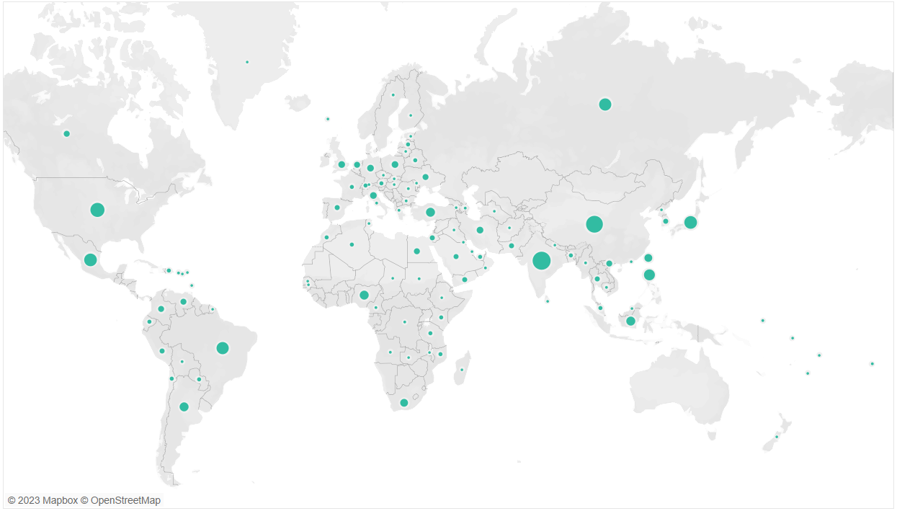
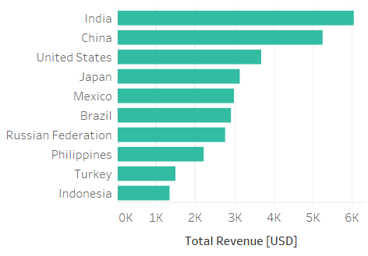
Revenue by Country
Total revenue across all 109 countries was $61,312.
India and China provided the highest revenue.

Slide 5
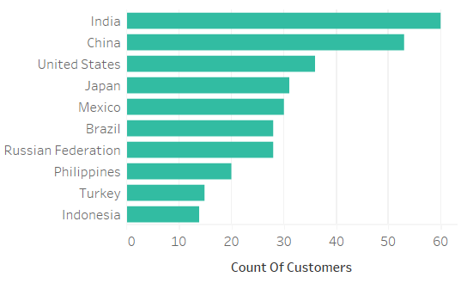
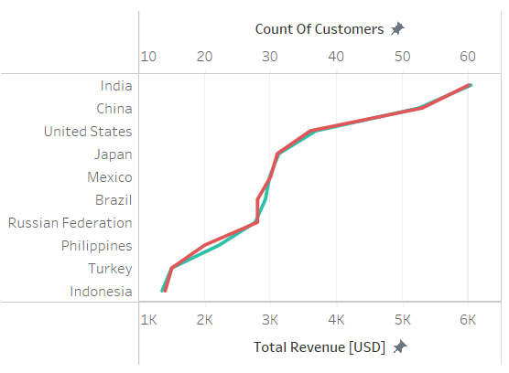

Customers per Country
Films were rented by a total of 599 customers.
There was a positive correlation between number of customers and total revenue per country.

Slide 6
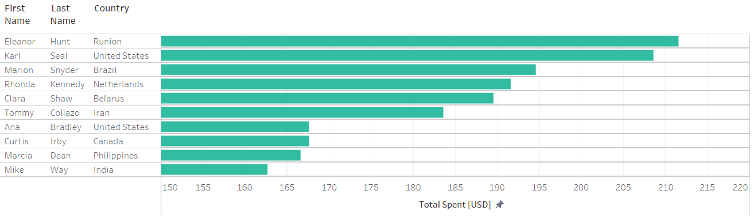
Top Lifetime Customers
The average spent per customer was $102.
Only 40% of these customers reside in the 10 countries with highest revenue.

Slide 7
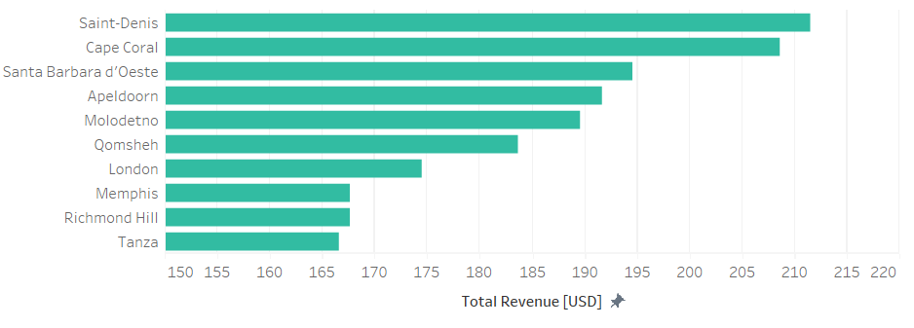
Revenue by City
Saint-Denis is not located within the top 10 countries, but it is the residential city of the top lifetime customer, Eleanor Hunt in the country Runion.

Slide 8
Analysis by Product
Film Rental Rate
Genres of Top 10 Films
Film Count by Genre
Rental Duration by Genre

Slide 9
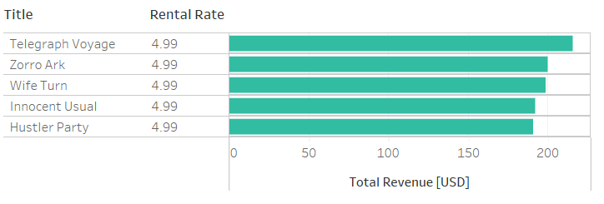
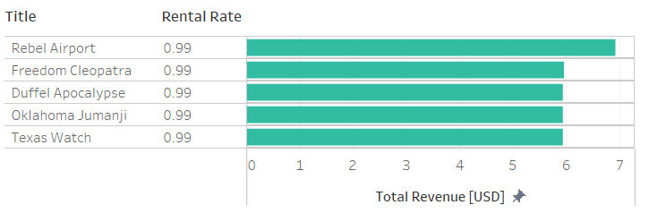
Film Rental Rate
There are 1000 films in inventory.
All films are in English with 2006 release dates.
The average rental rate was $2.98.
All the top films went for a rental rate of $4.99 while the lowest went for $0.99.

Slide 10
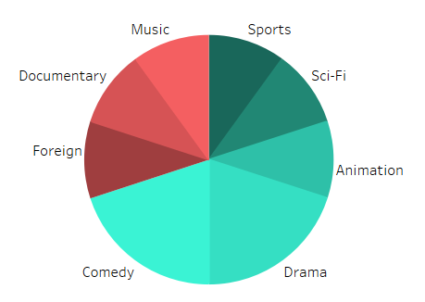
Genres of Top 10 Films
Film | Genre
Telegraph Voyage | Music
Zorro Ark | Comedy
Wife Turn | Documentary
Innocent Usual | Foreign
Hustler Party | Comedy
Saturday Lambs | Sports
Titans Jerk | Sci-Fi
Harry Idaho | Drama
Torque Bound | Drama
Dogma Family | Animation
70% of top 10 films featured genres identified to provide revenue greater than 4k.

Slide 11
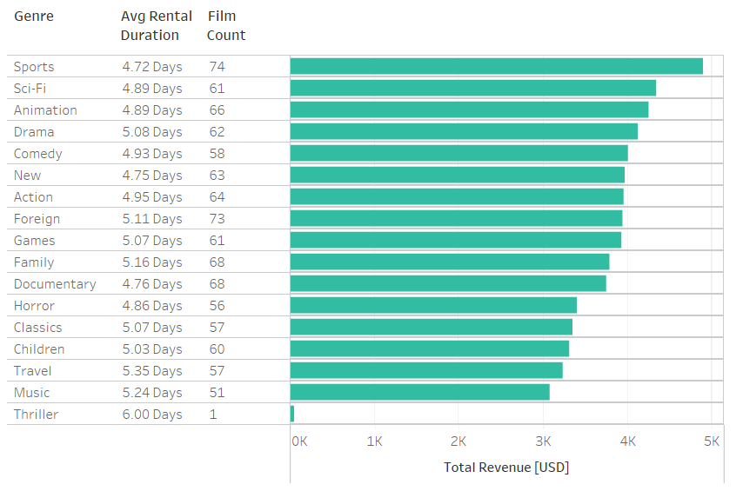
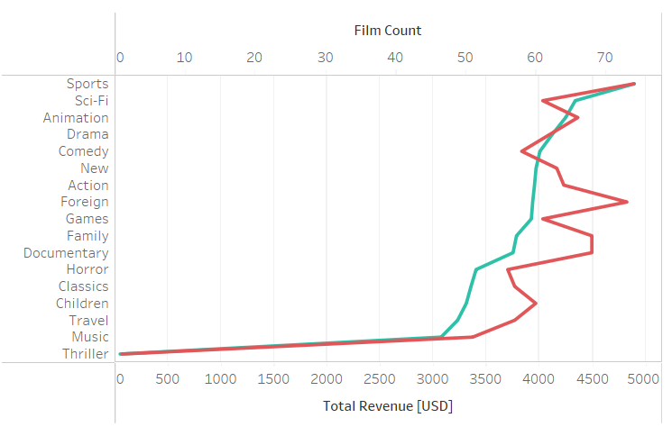

Film Count by Genre
There was a positive correlation between the number of films within a genre and the genre revenue.

Slide 12
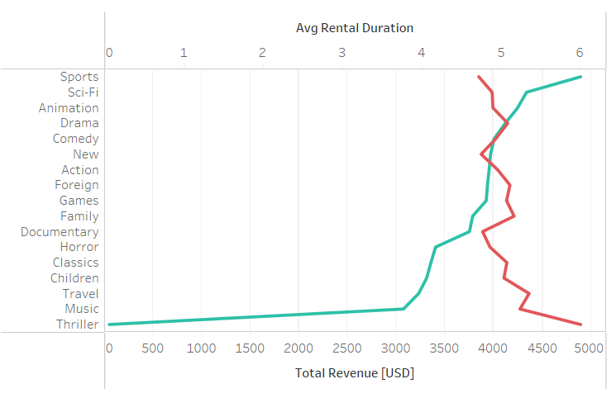

Rental Duration by Genre
Genre | Avg Rental Duration (days)
Thriller | 6.00
Travel | 5.35
Music | 5.24
Family | 5.16
Foreign | 5.11
Drama | 5.08
Classics | 5.07
Games | 5.07
Children | 5.03
Genre | Avg Rental Duration (days)
Action | 4.95
Comedy | 4.93
Animation | 4.89
Sci-Fi | 4.89
Horror | 4.86
Documentary | 4.76
New | 4.75
Sports | 4.72
The average rental duration per film was 4.99 days.
There was a negative correlation between rental duration and genre revenue.

Slide 13
Conclusion
Recommendations
References

Slide 14
Recommendations
Customer Base
Target markets in high revenue countries such as India, China, and United States.
Consider loyalty program to hold onto lifetime customers.
Consider referral discounts to increase customer numbers in existing markets.
Inventory Expansion
Continue to supply high revenue genres such as Sports, Sci-Fi, and Animation.
Boost inventory of other genres belonging to popular movies such as Foreign, Documentary, and Music.
Include films spanning years outside of 2006 to interest customers within various demographics.
Increase variety of languages especially those common in the high revenue countries identified.

Slide 15
References
Tableau Public https://public.tableau.com/app/profile/courtney.shatley/viz/Task3_10RockbusterStealth/Map
Related Documents
Task 3.10 Data Dictionary cshatley
Task 3.10 SQL Exports cshatley
Thank you!

